Slide 1
Investigating impact of reflections on voltage resonance in transmission lines
10 November 2023
----- A comparison between the gain in open-end and impedance-matched transmission lines
Ziyao Xiong, Riadh Khlif

Slide 2
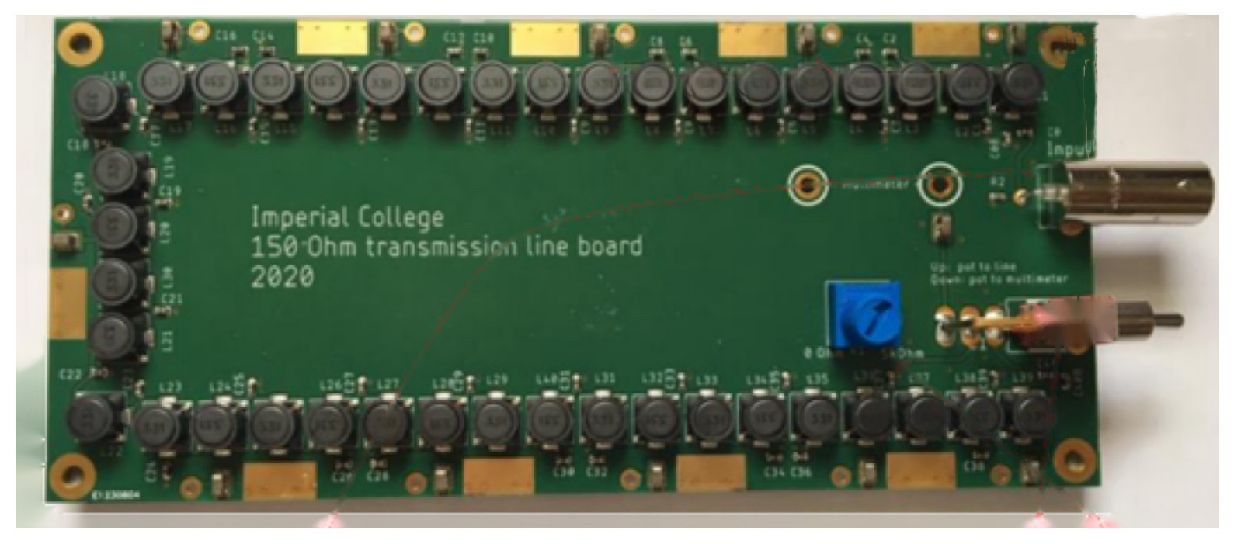
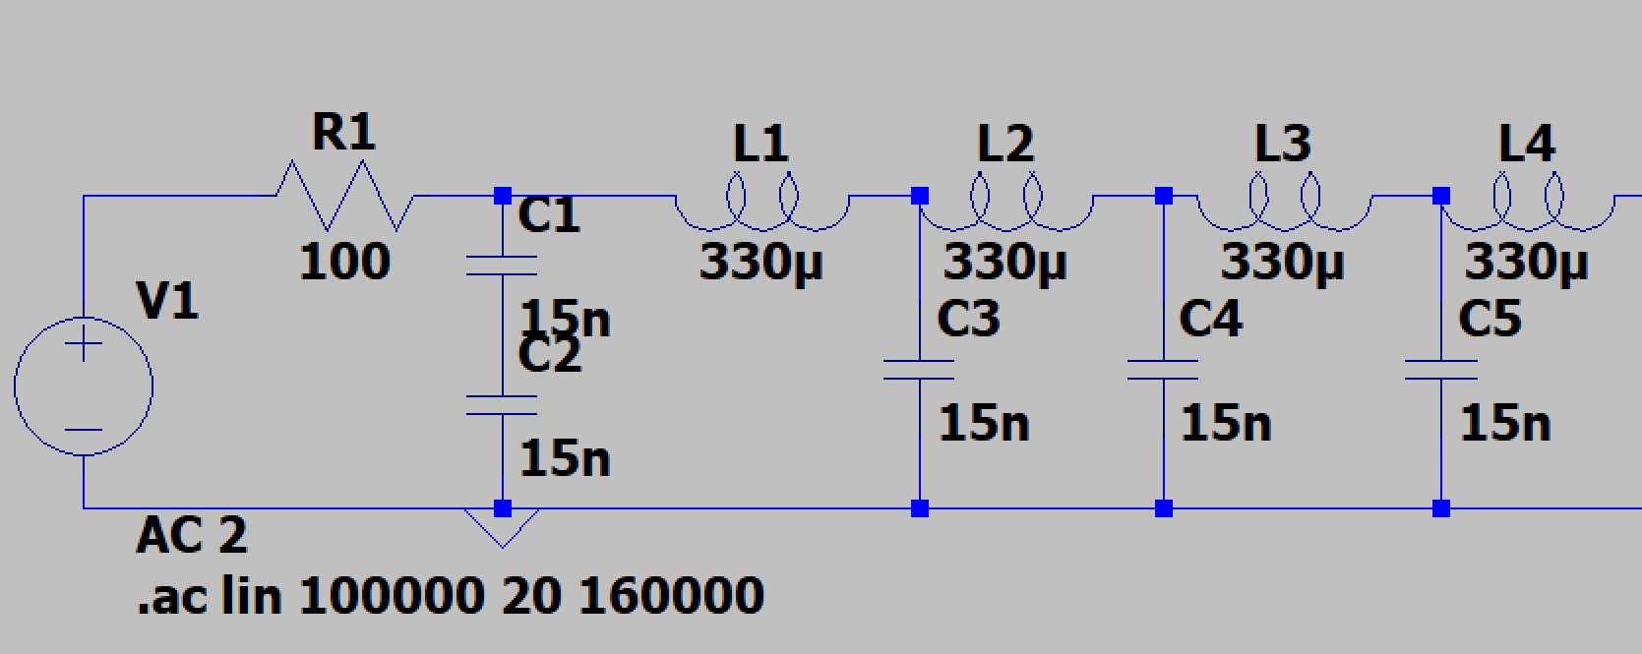
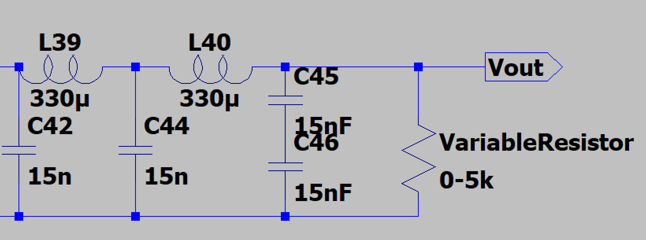
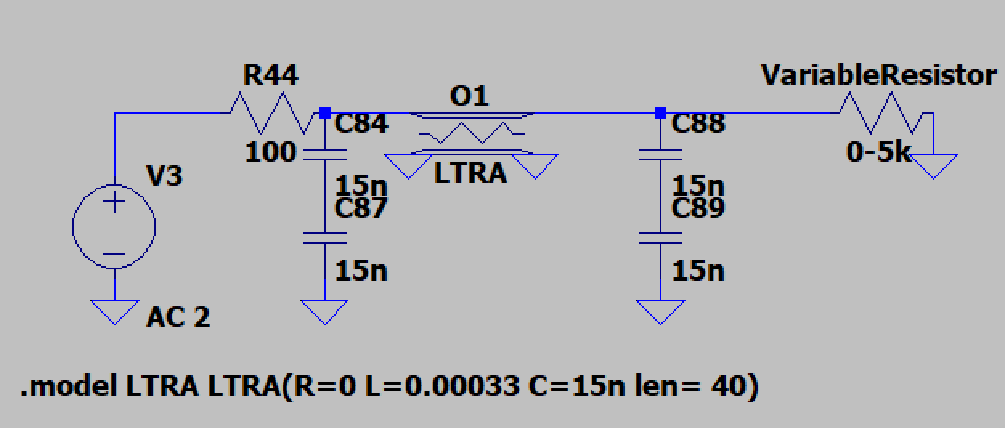
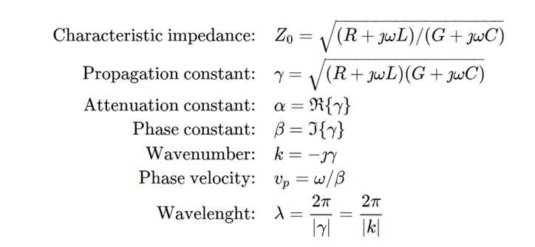
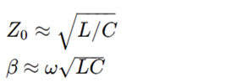
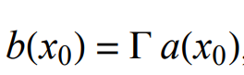
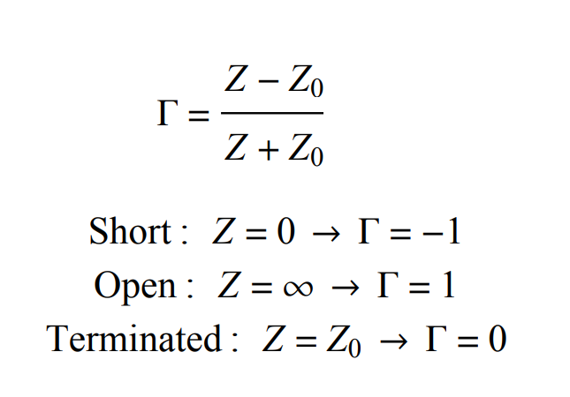
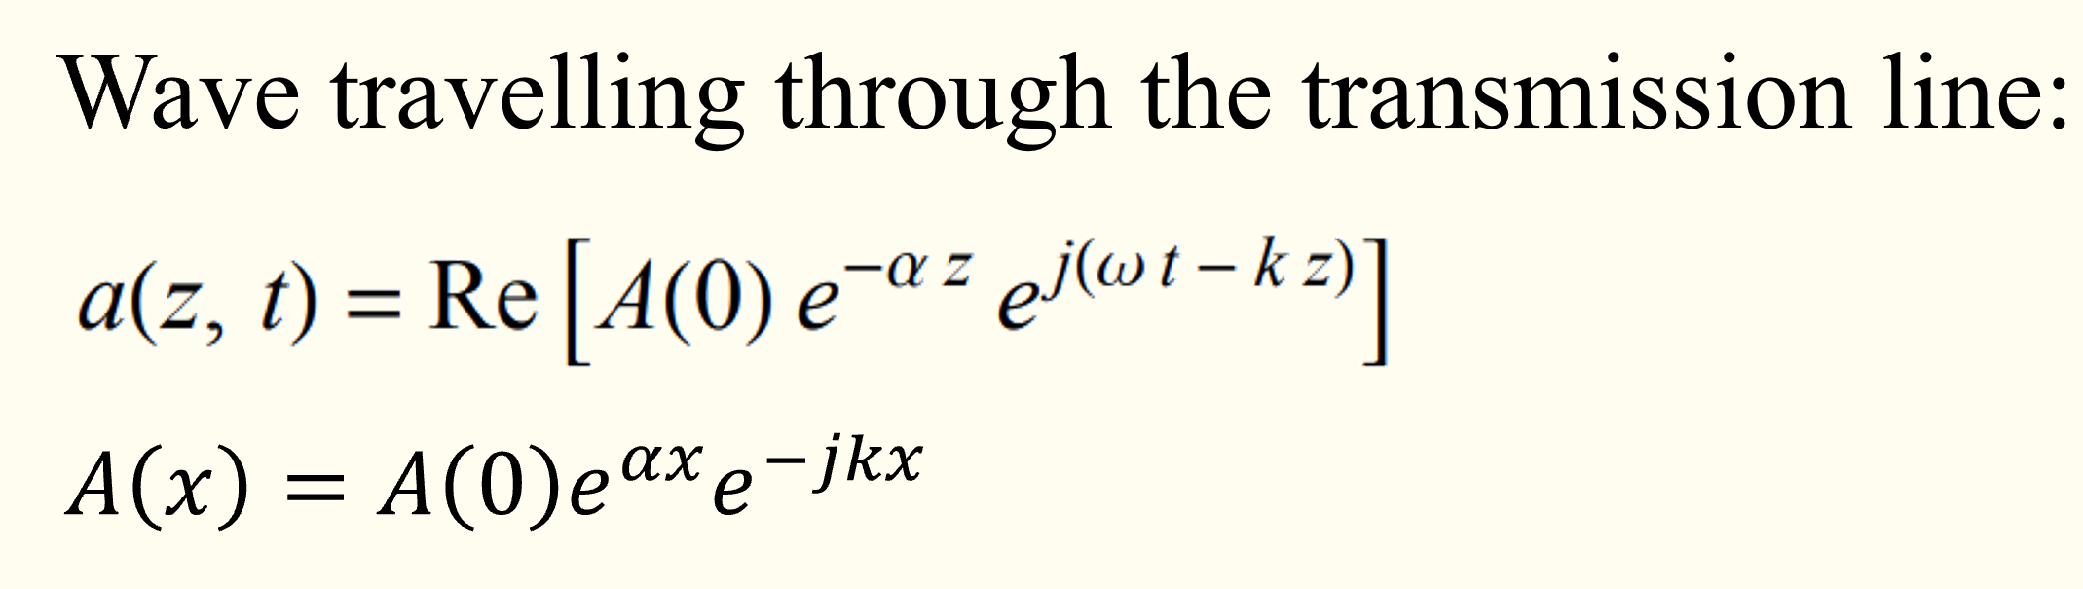
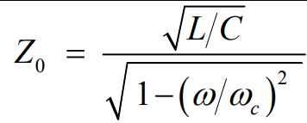
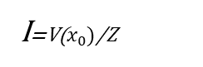
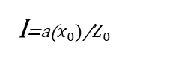
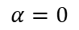
Introduction
Transmission Line Resonance due to Reflections
10 November 2023
Node 0
Node 40
…
I=a($x_{0})$/$Z_{0}$
I=V($x_{0})$/Z
If Z≠Z₀, then the boundary condition on the voltage and current at x₀ requires that a wave b(x) propagate away from the termination, where a(x)+b(x)=V(x). [1]
Lossless line
$$α=0$$
[1] Transmission line text.new - California Institute of Technology, http://www.sophphx.caltech.edu/Physics_6/Experiment_Notes/Appendix.Trans_Line.pdf (accessed Nov. 8, 2023).

Slide 3
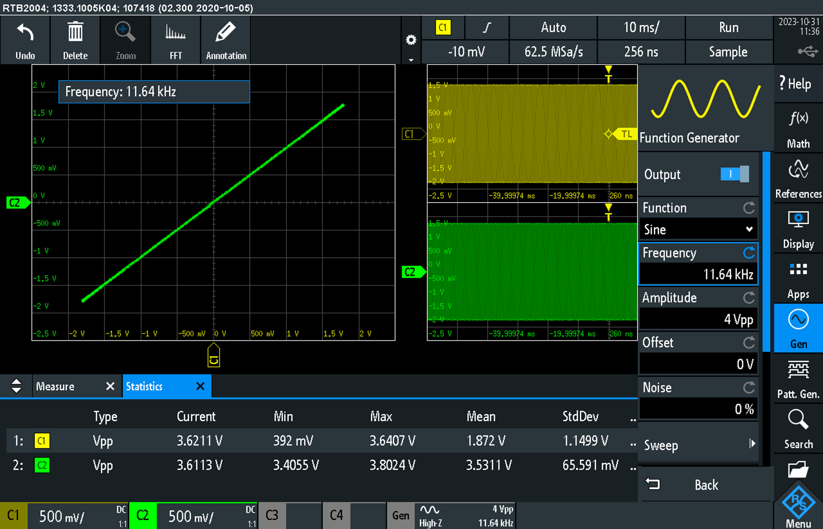
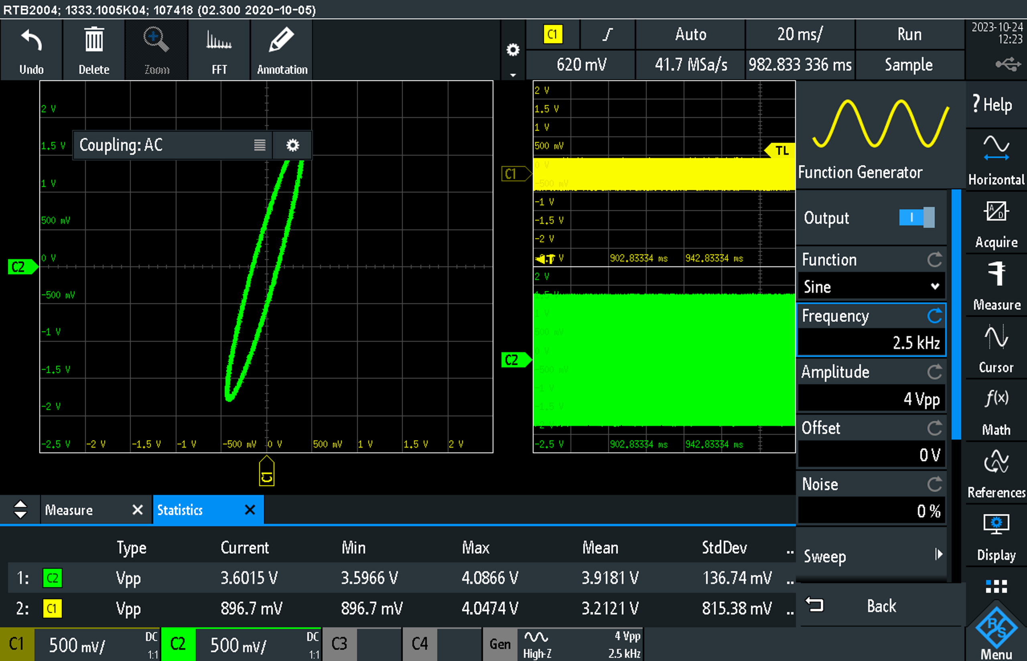
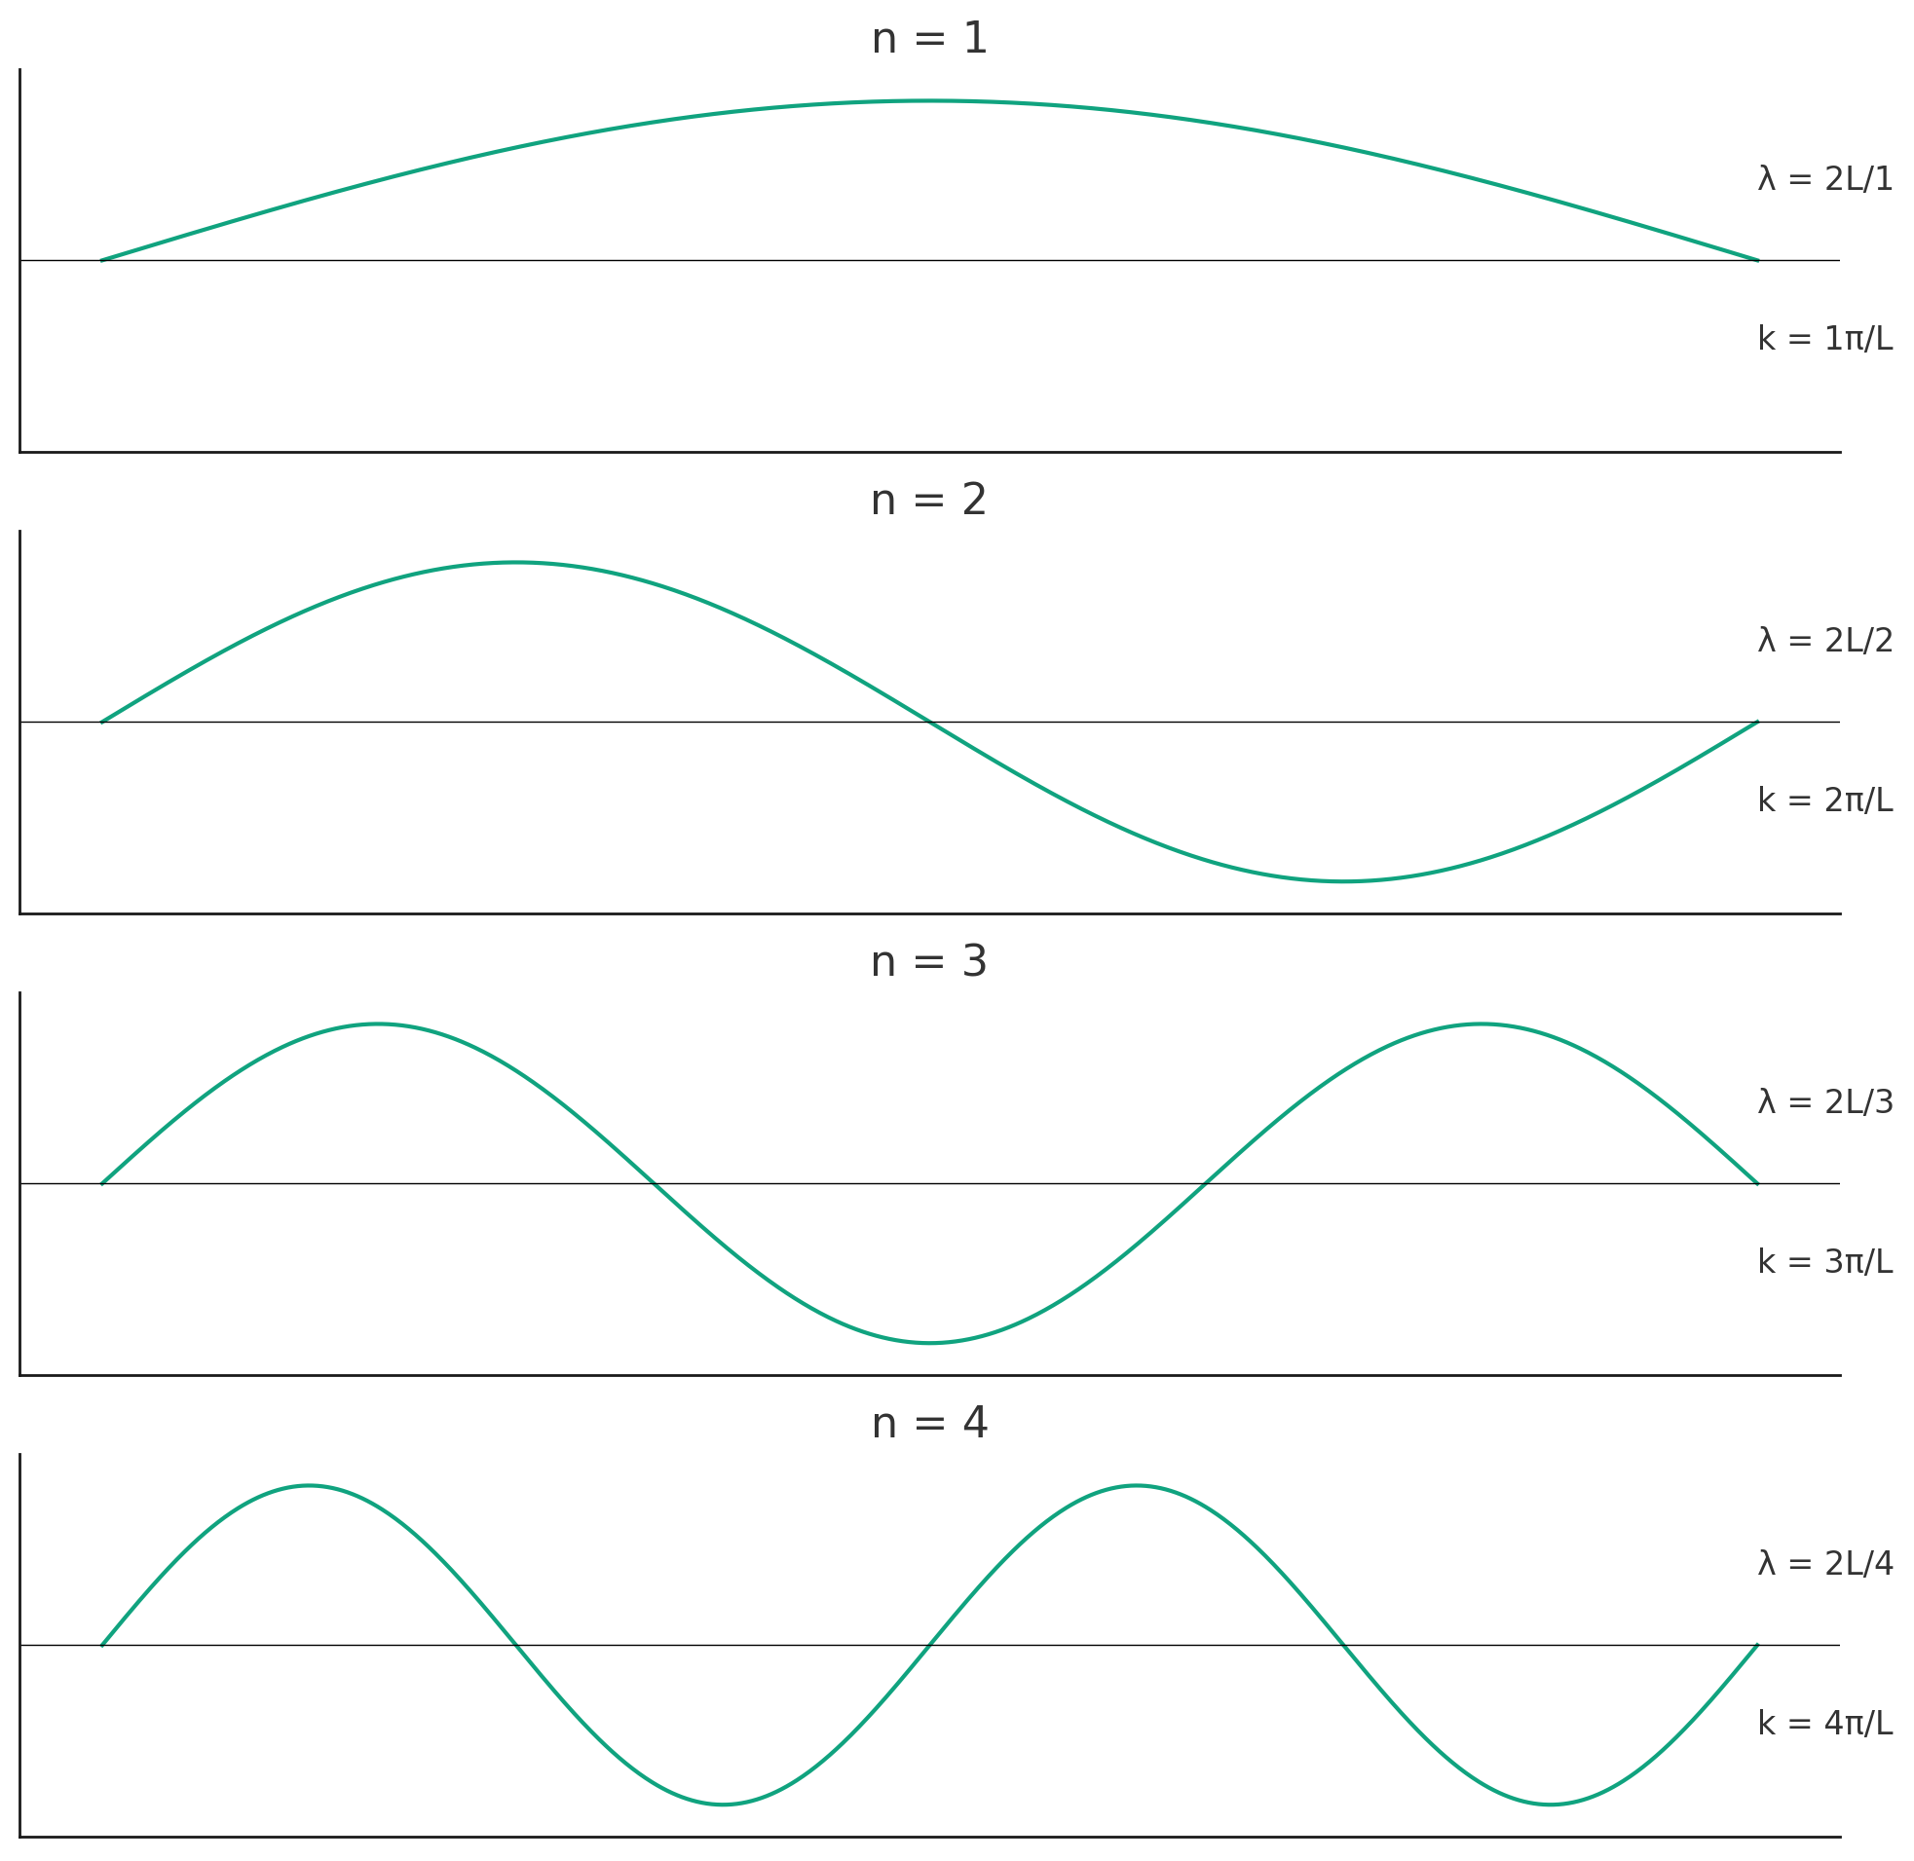
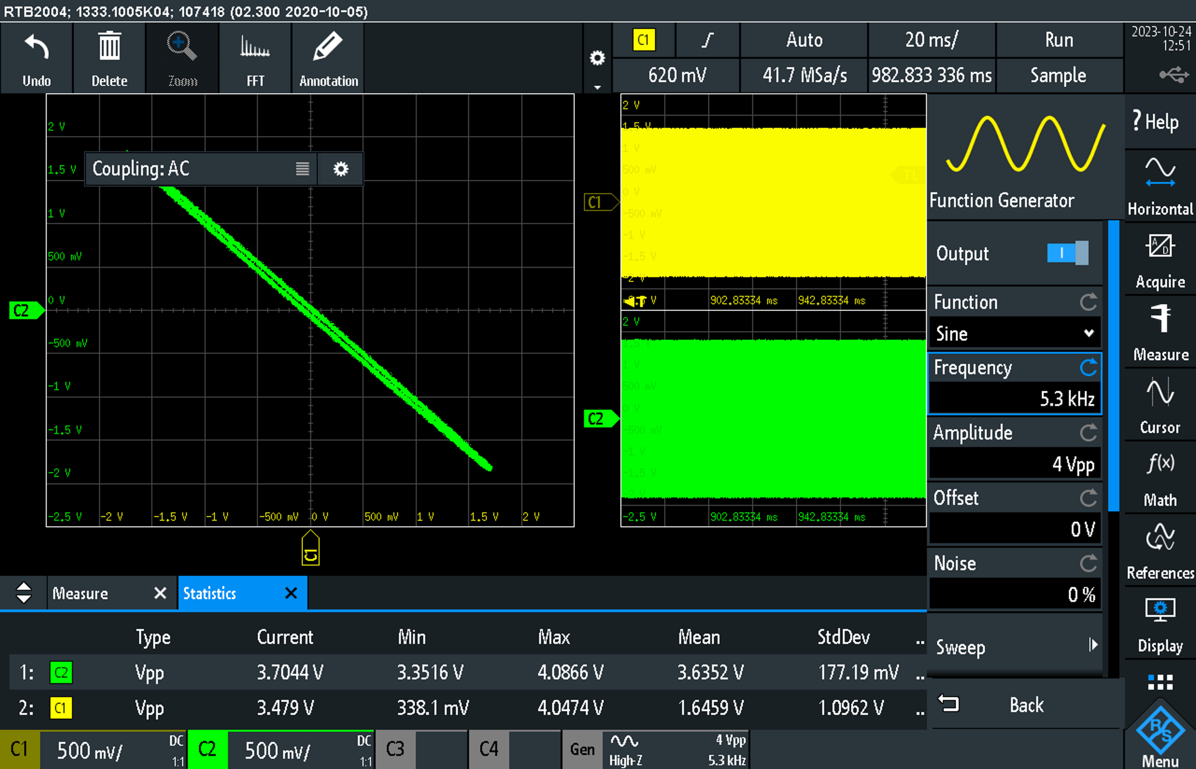
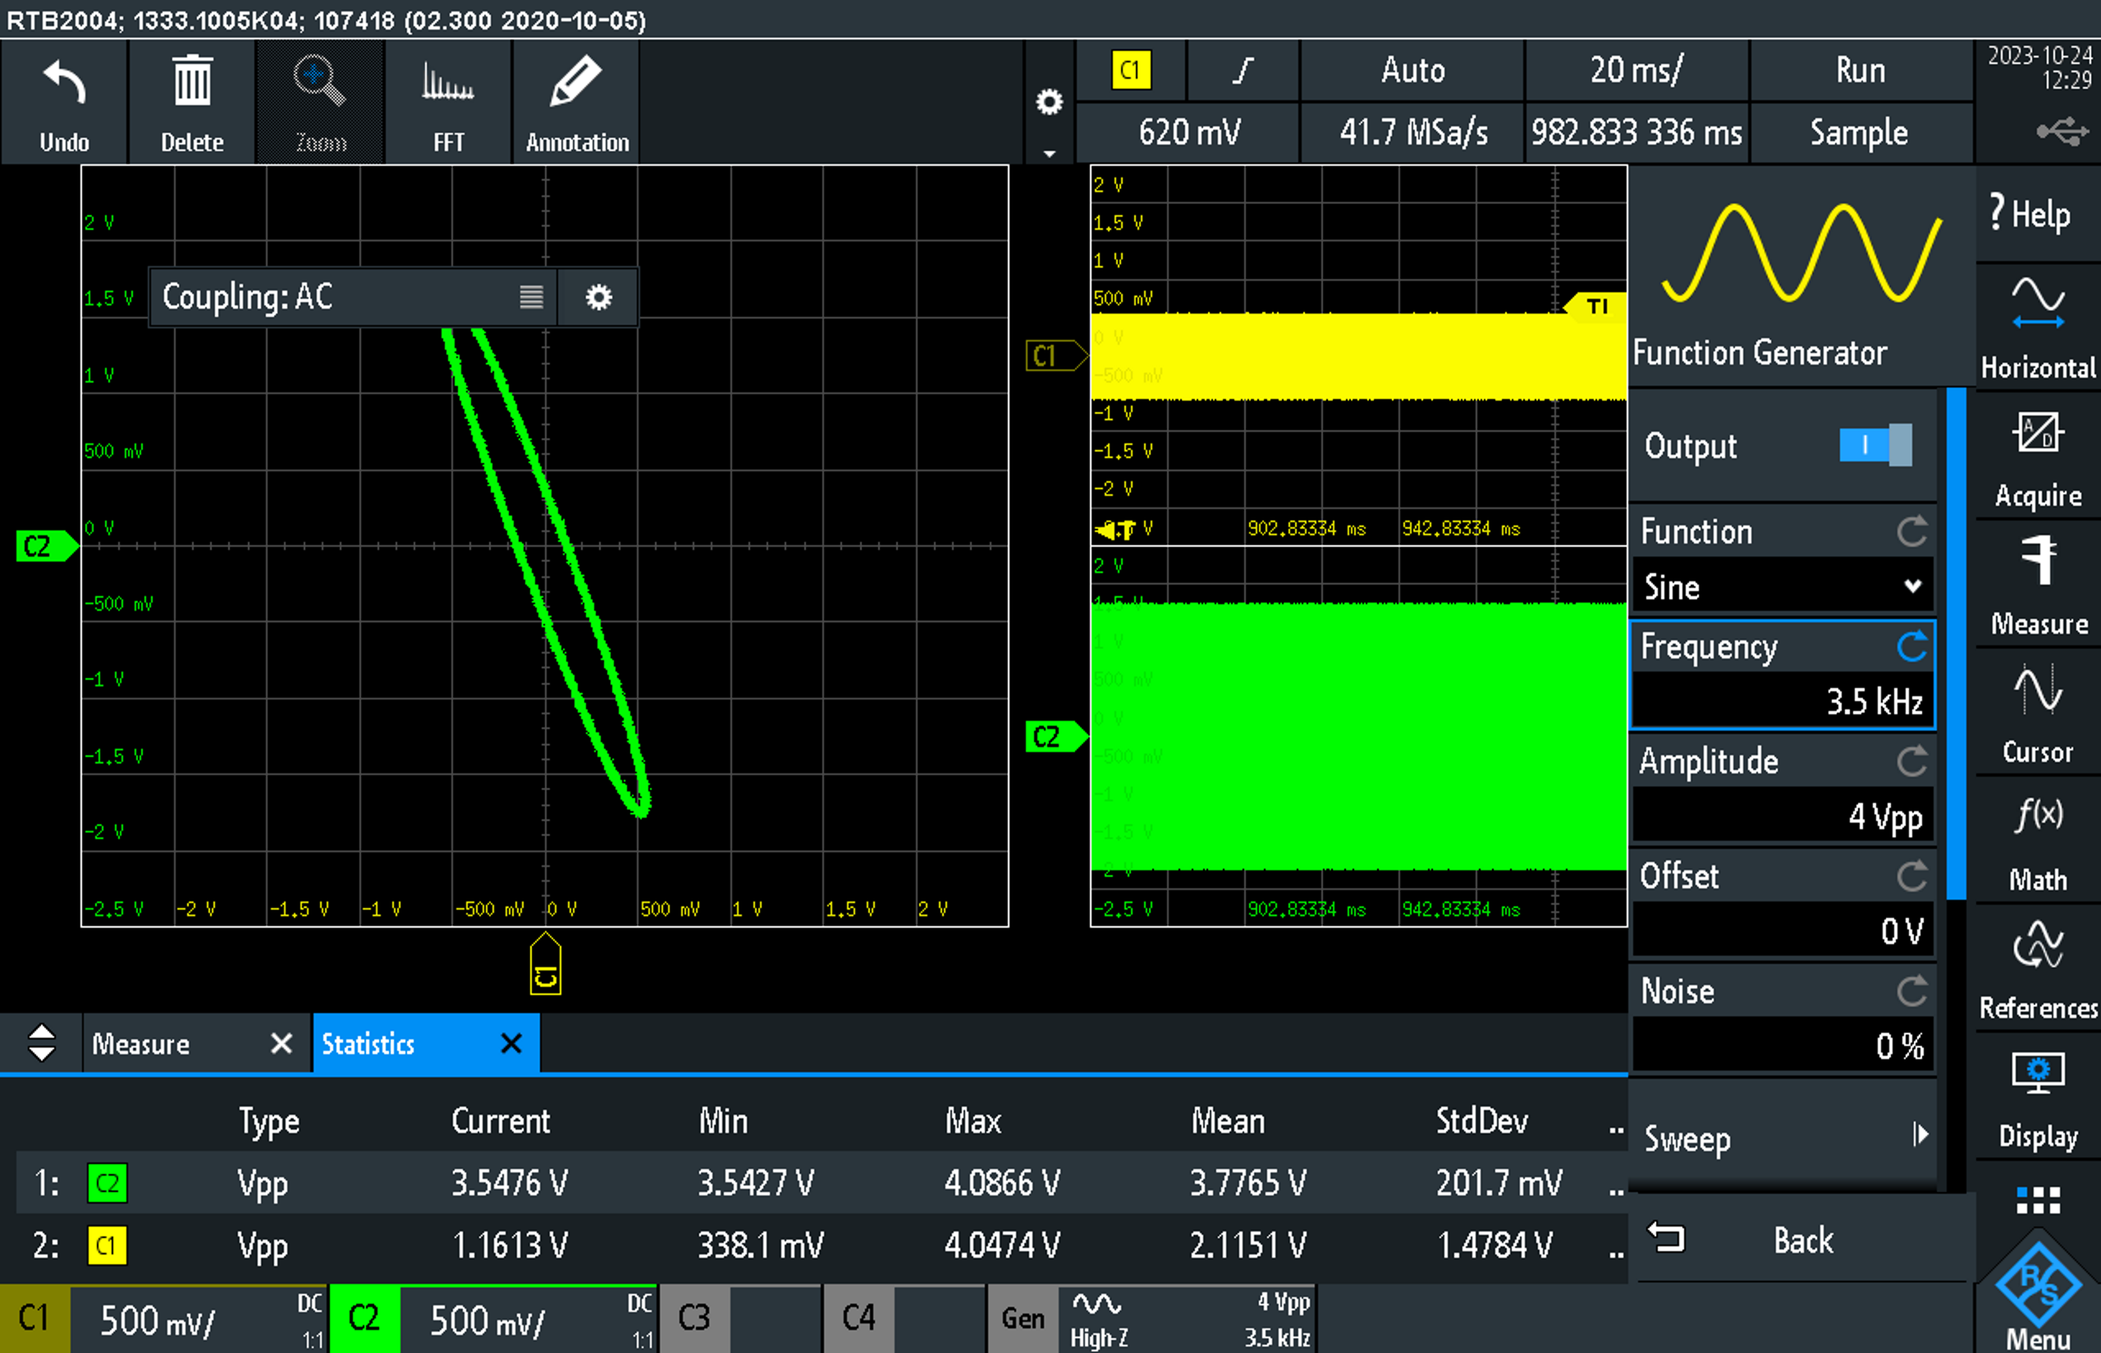
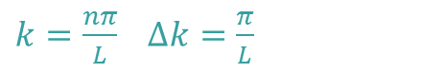
Impedance-matched measurements
Transmission Line Resonance due to Reflections
10 November 2023
In phase (n=1,3,5,…)
Out of phase (n=2,4,6,…)
$k=\frac{nπ}{L}$ $∆k=\frac{π}{L}$

Slide 4
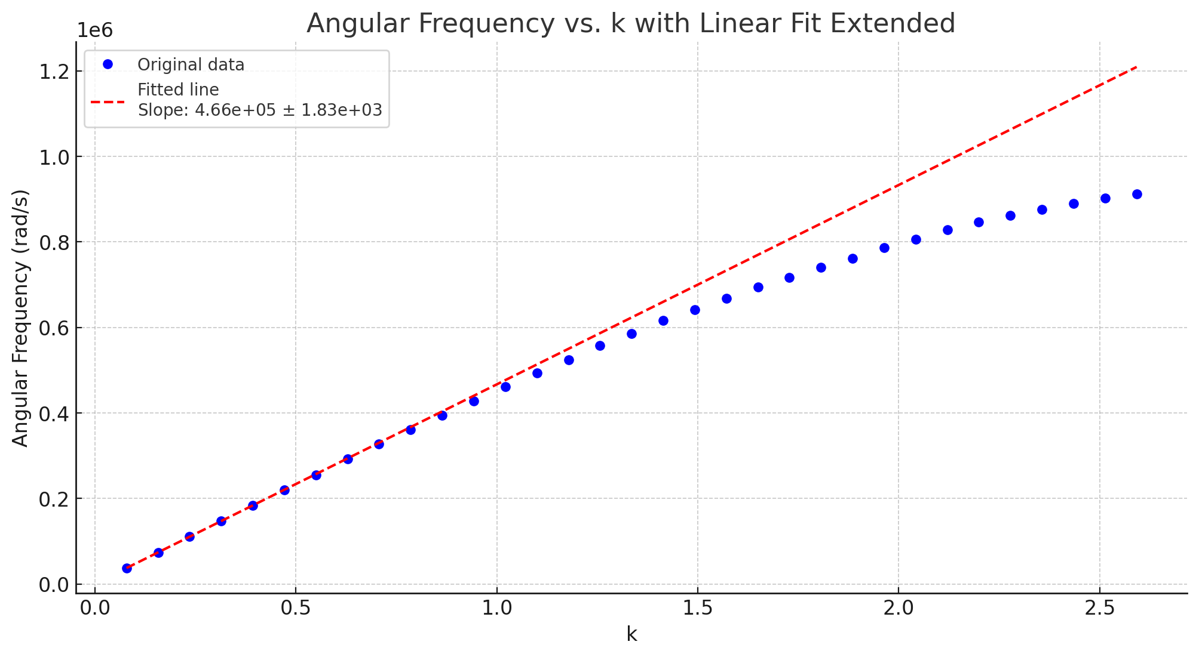
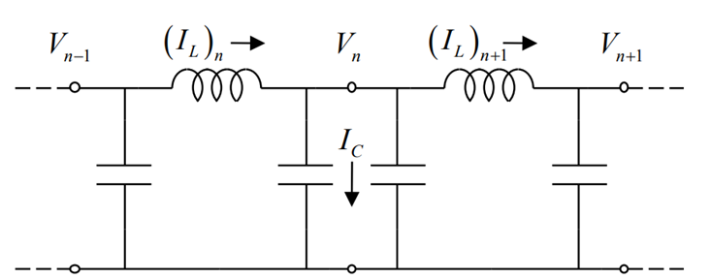
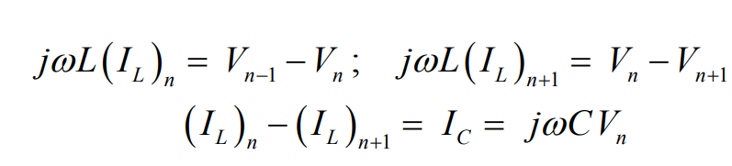
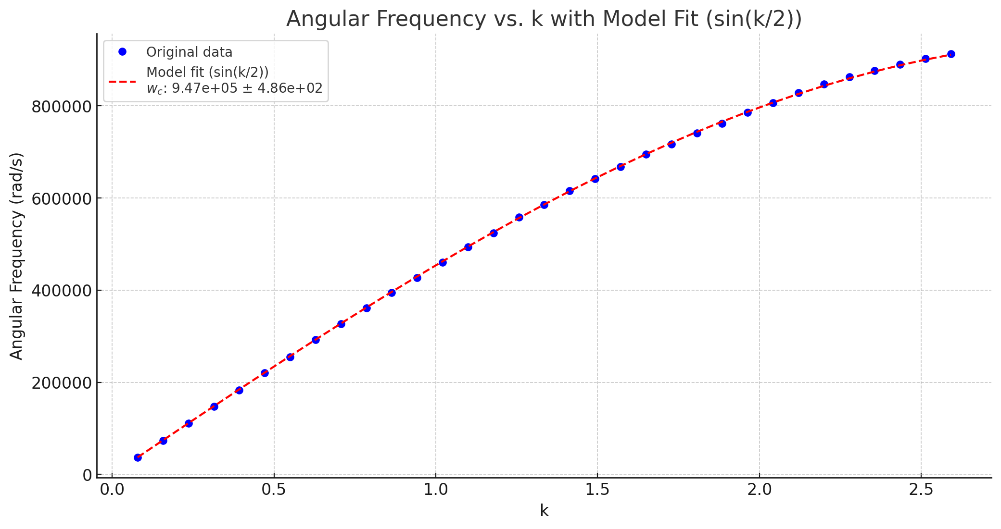
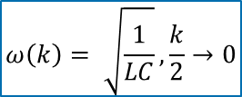
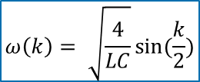
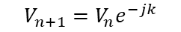
Impedance-matched measurements
Transmission Line Resonance due to Reflections
10 November 2023
$$V_{n+1}=V_{n}e^{−jk}$$
Cut off frequency
[2]
$$ω\left(k\right)= \sqrt{\frac{4}{LC}}sin⁡(\frac{k}{2})$$
 | Phase velocity (10e5 section/s) | Cut off ω (10e5 rad/s)
Theoretical | 4.49+/-0.69 | 8.98+/-0.69
Fitted | 4.66+/-0.02 | 9.47+/-0.01
Phase velocity (non-dispersive)
$$ω\left(k\right)= \sqrt{\frac{1}{LC}}, \frac{k}{2}→0$$
[2] O. Sydoruk, “Transmission Lines II,” in Electromagnetism lecture notes, London, United Kingdom: Imperial College London, 2023, pp. 95–106

Slide 5
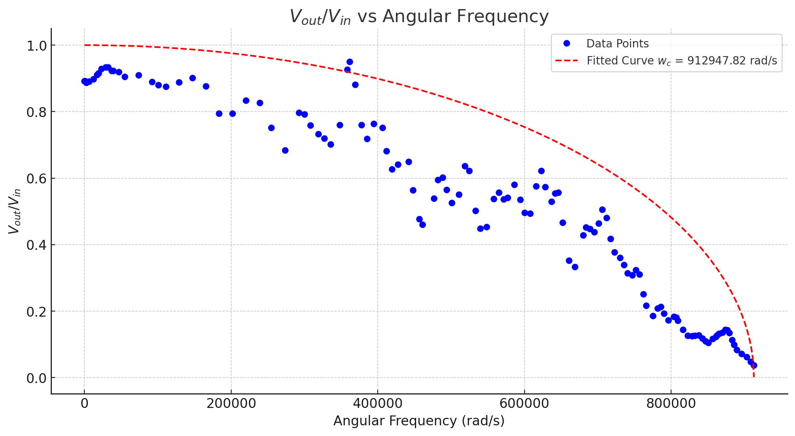
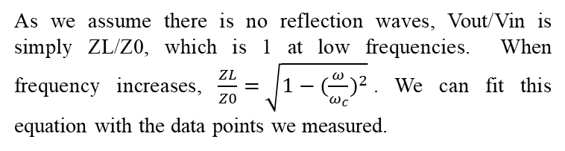
Impedance-matched measurements
Transmission Line Resonance due to Reflections
10 November 2023
Features:
The ratio starts below 1, indicating that there is some loss in the transmission line or an impedance mismatch right from the start.
The line does not appear to be flat, suggesting that there are still some reflections.
The transmission line's characteristic impedance varies with the frequency.
As we assume there is no reflection waves, Vout/Vin is simply ZL/Z0, which is 1 at low frequencies. When frequency increases, $\frac{ZL}{Z0}=\sqrt{1−{(\frac{ω}{ω_{c}})}^{2}}$. We can fit this equation with the data points we measured.
Fitted cutoff frequency = 9.13+/-0.23 rad

Slide 6
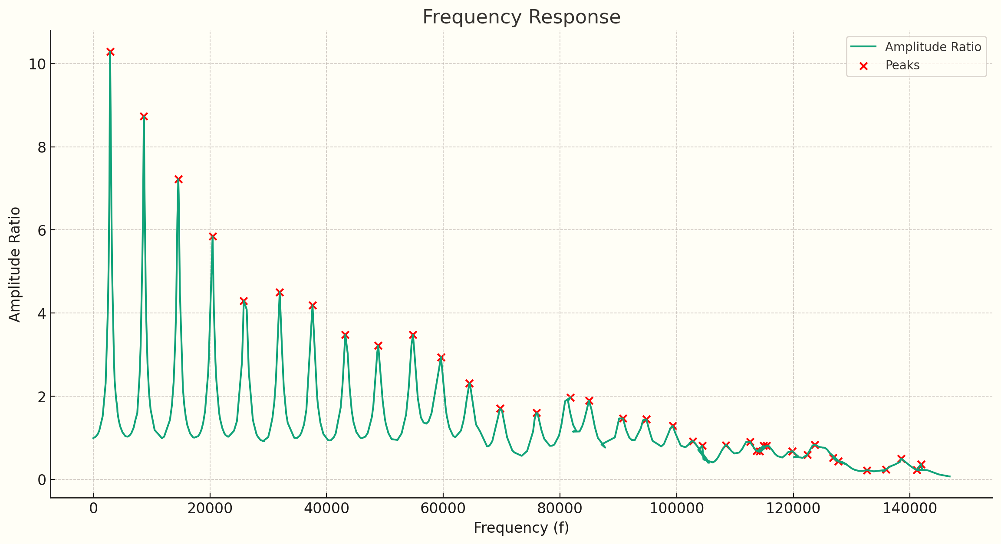
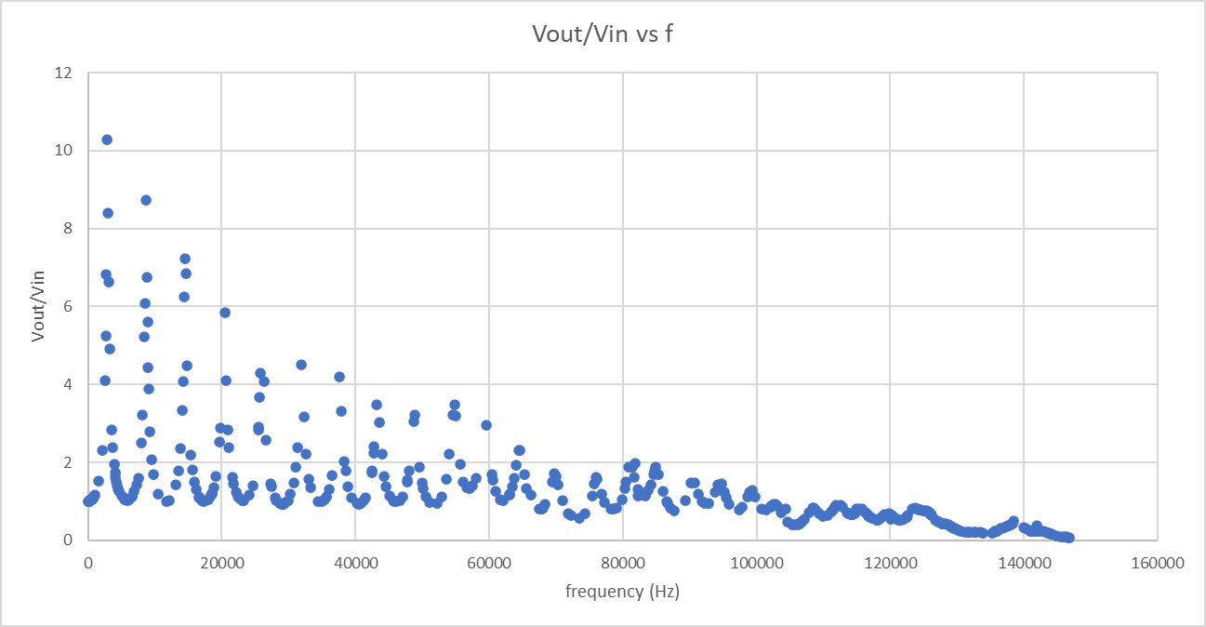
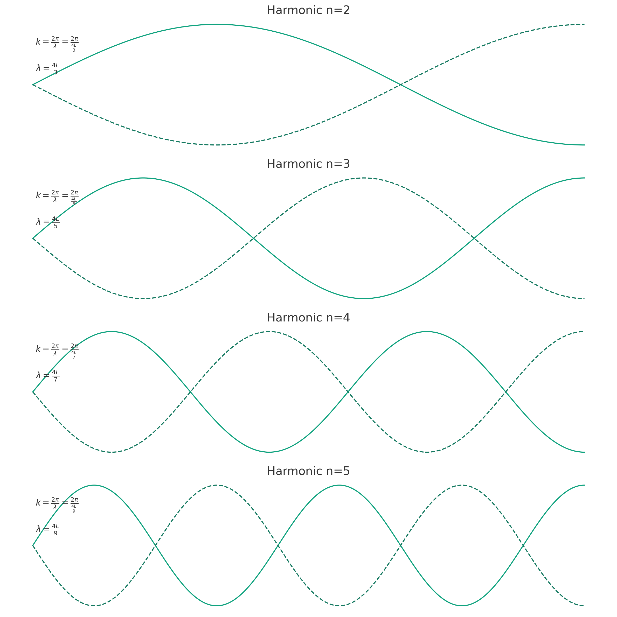
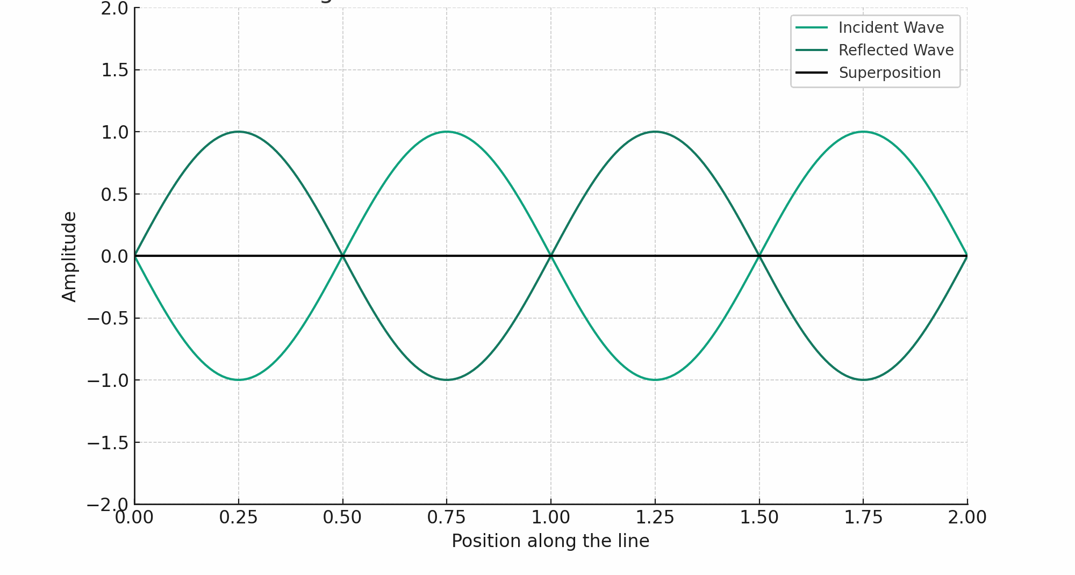
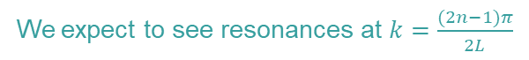
Open-end measurements
Transmission Line Resonance due to Reflections
10 November 2023
n | f (Hz) | k | Theoretical k | |(k-kt)/kt|
1 | 2881 | 0.0382 | 0.0393 | 0.0264
2 | 8667 | 0.1151 | 0.1178 | 0.0232
3 | 14570 | 0.1936 | 0.1963 | 0.0138
4 | 20450 | 0.2722 | 0.2749 | 0.0098
5 | 25790 | 0.3439 | 0.3534 | 0.0269
6 | 31960 | 0.4273 | 0.432 | 0.0107
7 | 37580 | 0.504 | 0.5105 | 0.0128
8 | 43200 | 0.5814 | 0.589 | 0.013
9 | 48850 | 0.6601 | 0.6676 | 0.0112
10 | 54800 | 0.7442 | 0.7461 | 0.0025
11 | 59610 | 0.8132 | 0.8247 | 0.0139
12 | 64480 | 0.8841 | 0.9032 | 0.0211
13 | 69710 | 0.9617 | 0.9817 | 0.0205
14 | 75980 | 1.0567 | 1.0603 | 0.0034
15 | 81820 | 1.1477 | 1.1388 | 0.0078
16 | 84960 | 1.1977 | 1.2174 | 0.0162
17 | 90800 | 1.2931 | 1.2959 | 0.0022
18 | 94820 | 1.3608 | 1.3744 | 0.0099
19 | 99320 | 1.4389 | 1.453 | 0.0097
20 | 102800 | 1.5012 | 1.5315 | 0.0198
We expect to see resonances at $k=\frac{(2n−1)π}{2L}$

Slide 7
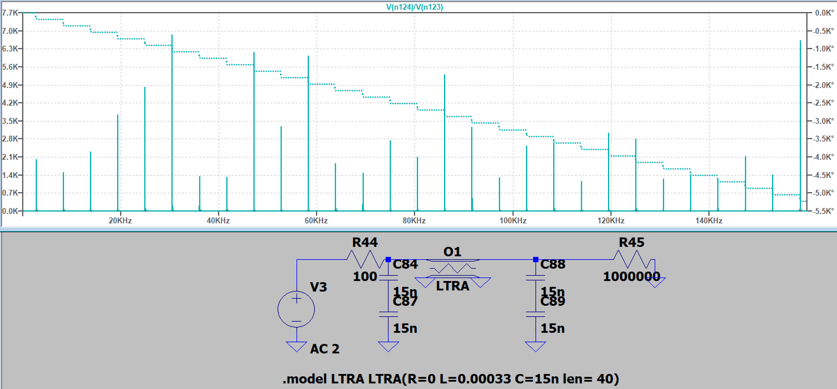
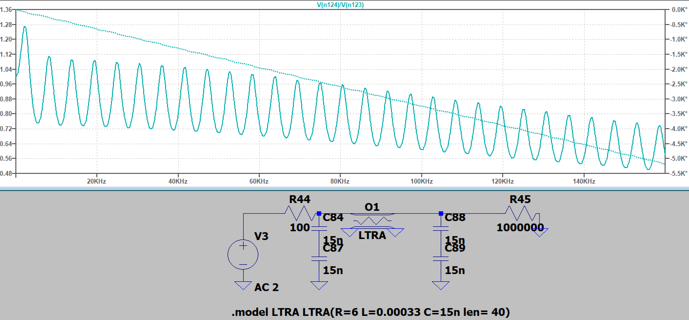
Open-end simulations
Transmission Line Resonance due to Reflections
10 November 2023
Vout/Vin against frequency
Same resonance positions
Transmission line R=0
Direct delta functions with Q=∞
Vout/Vin against frequency
Same resonance positions
Transmission line R=6
Direct delta functions with a considerable Q
Damped oscillator

Slide 8
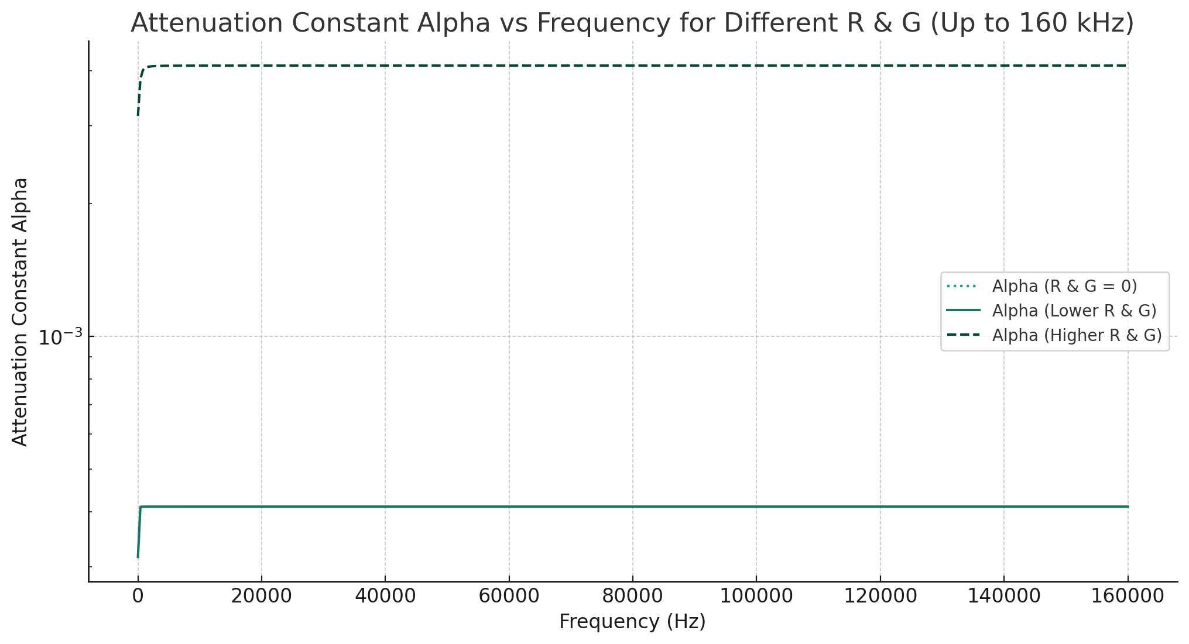
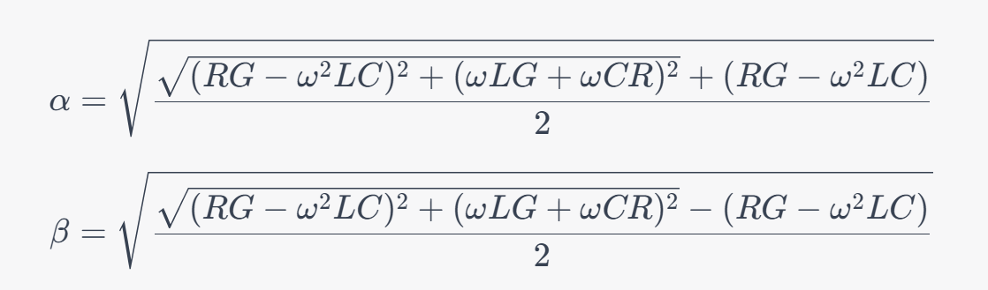
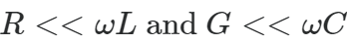
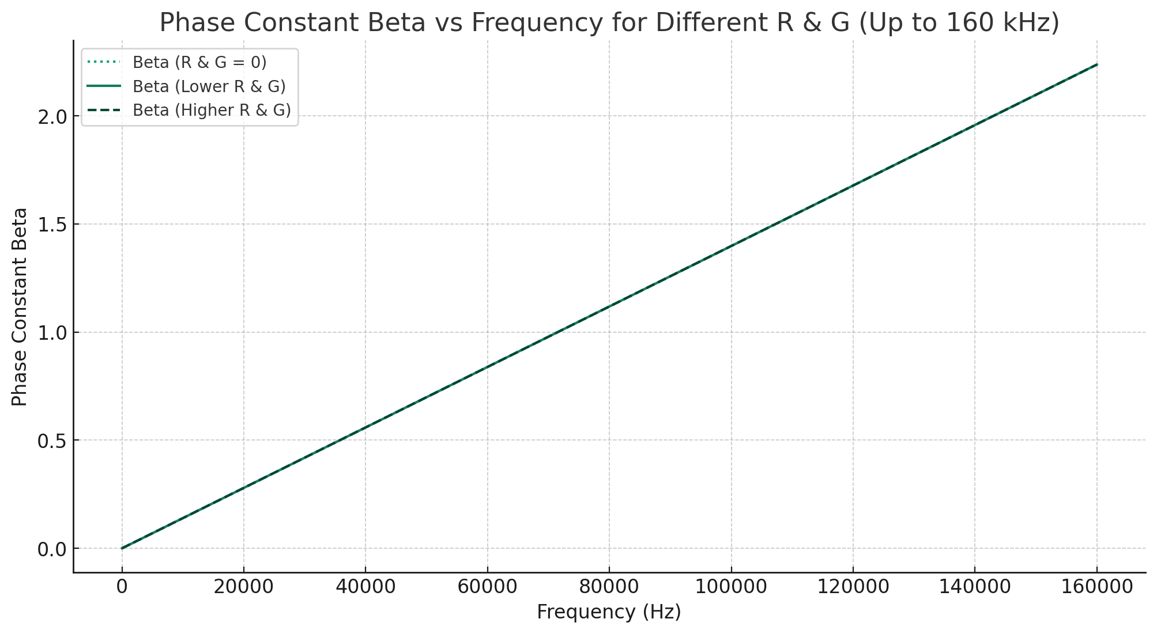
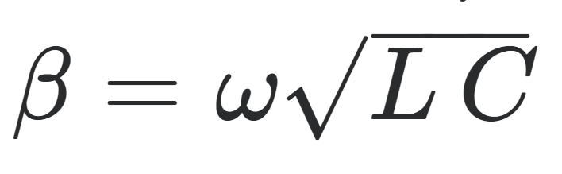
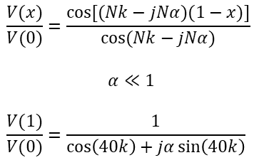
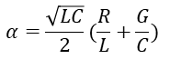
Open-end simulations
Transmission Line Resonance due to Reflections
10 November 2023
R=0 G=0 (lossless line)
R=0.1 G=1e-6 (typical transmission line)
R=1 G=1e-5 (higher values)
[3]
$$α=\frac{\sqrt{LC}}{2}(\frac{R}{L}+\frac{G}{C})$$
$$\frac{V(x)}{V(0)}=\frac{cos⁡[(Nk−jNα)(1−x)]}{cos⁡(Nk−jNα)}$$
$$α≪1$$
$$\frac{V(1)}{V(0)}=\frac{1}{\cos\left(40k\right)+jα\sin\left(40k\right)}$$
[3] M. Steer, “2.2: Transmission line theory,” Engineering LibreTexts, https://eng.libretexts.org/Bookshelves/Electrical_Engineering/Electronics/Microwave_and_RF_Design_II_-_Transmission_Lines_(Steer)/02%3A_Transmission_Lines/2.02%3A_Transmission_Line_Theory#:~:text=If%20the%20boundary%20conditions%20on,frequency%20is%20below%20fc. (accessed Nov. 8, 2023).

Slide 9
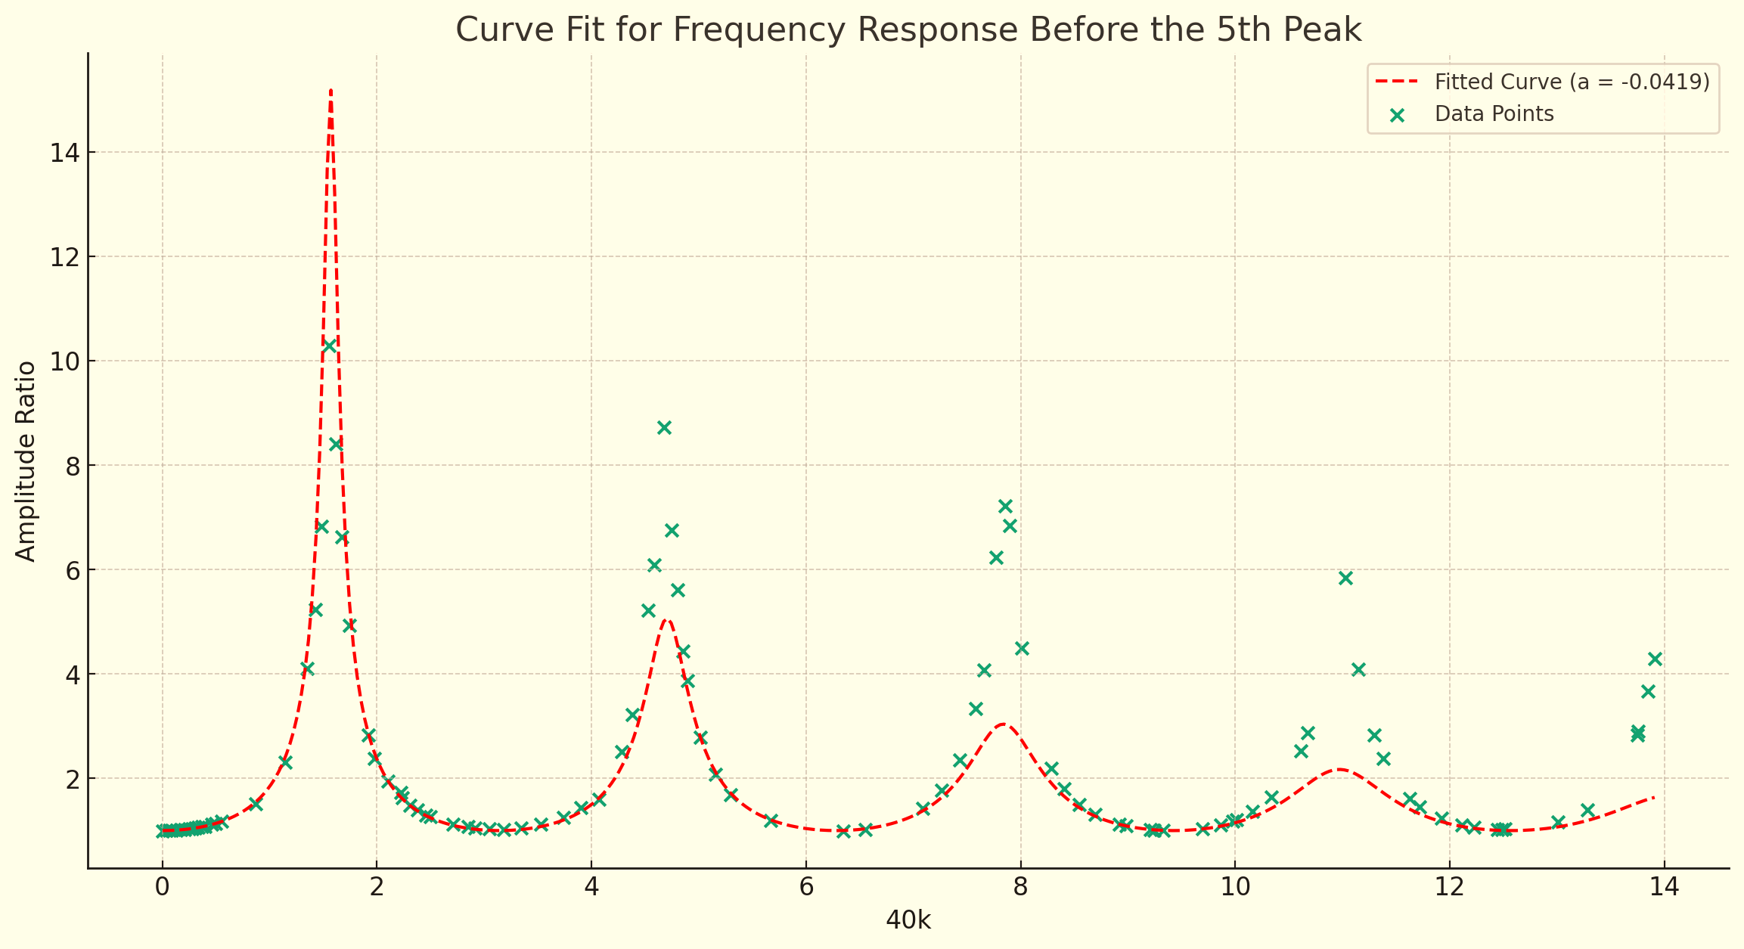
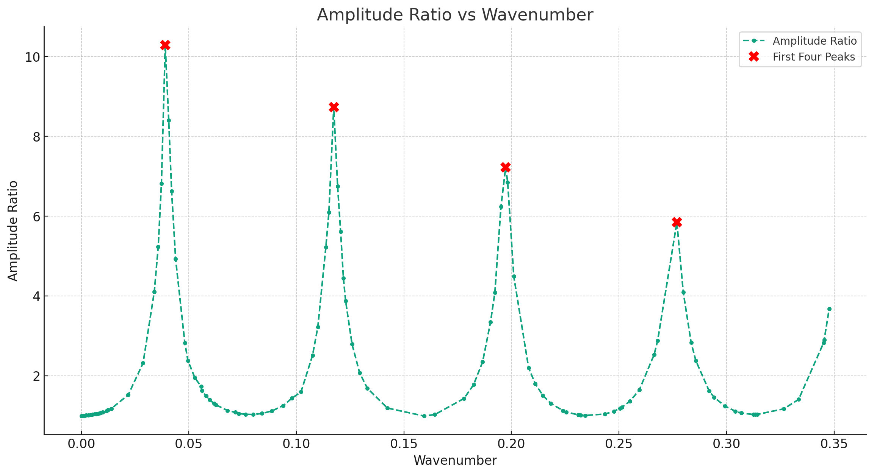
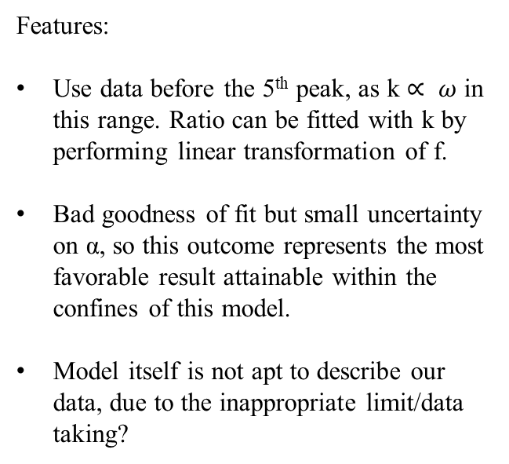

Open-end measurements
Transmission Line Resonance due to Reflections
10 November 2023
Features:
Use data before the 5th peak, as k $∝ ω$ in this range. Ratio can be fitted with k by performing linear transformation of f.
Bad goodness of fit but small uncertainty on α, so this outcome represents the most favorable result attainable within the confines of this model.
Model itself is not apt to describe our data, due to the inappropriate limit/data taking?
$$|\frac{V\left(1\right)}{V\left(0\right)}|=\frac{1}{\sqrt{\cos^{2}\left(40k\right)+α^{2}\sin^{2}(40k)}}$$
Fitted α = 0.04194+/-0.0025
R=12.5-22000G

Slide 10
Summary and Evaluation
Transmission Line Resonance due to Reflections
10 November 2023
Impedance-matched transmission line at terminations
Observed data of voltage versus frequency contrasted with assumed model: reflection occurred at terminations
Assumed no resistance in transmission line
Clashed with digital simulations and experimental data: resistance cannot be neglected
Attenuation of transmission line is minimal
Obtained response curve for the modulus voltage amplitude ratio: characteristic of resonant systems
Attenuation factor: do not have a theoretical value
R & G: unable to obtain specific values

